Slide 1

4-Bit Computer
EEE 315 Assignment
Student Name : Mir Sayeed Mohammad
Student ID : 1606003
Submitted to : Dr. Sajid Muhaimin Choudhury
&
Sameia Zaman

Slide 2
4-Bit Computer
EEE 315 Assignment
Presentation Video Link: https://web.microsoftstream.com/video/7864c76b-9f30-431f-8024-b9580b2b1209
EDA-Playground Link:
https://www.edaplayground.com/x/pwQy
Verilog and Python Codes:
https://github.com/ClockWorkKid/Microprocessor/tree/main/Assignment%204-Bit%20Computer

Slide 3
Objectives
Instruction Set
0 | ADD A, B
1 | SUB A, B
2 | XCHG B, A
3 | IN A
4 | OUT A
5 | INC A
6 | MOV A, [ADDR]
7 | MOV A, BYTE
8 | JZ ADDRESS
9 | PUSH B
10 | POP B
11 | RCL B
12 | CALL ADDRESS
13 | RET
14 | AND A, [ADDR]
15 | HLT
Covered in the assignment:
Implementation of a 4-bit computer using Verilog for given instruction set
Programming and testing the computer on EDA-Playground with test-bench code and waveform output
Designing a python based assembler for the computer unit

Slide 4
Verilog Module
module computer (data_in, data_out, osc_clock, reset, prog_in, prog_clk, prog_add);
computer
data_in[3:0]
data_out[3:0]
osc_clock
reset
prog_add[3:0]
prog_in[7:0]
prog_clk

Slide 5
Main Module
data_out[3:0]
COMPUTER
reg [3:0] A
reg [7:0]
PROG_MEM
[15:0]
data_in[3:0]
reg [3:0] B
osc_clock
reset
reg [3:0] tmp
reg [3:0]
DATA_MEM
[15:0]
reg [3:0] IP
prog_in[7:0]
reg [3:0] SP
reg [3:0]
STACK_MEM
[15:0]
prog_add[3:0]
reg [3:0] INS
prog_clk
reg [3:0] ADD
HALT_FLAG
CF
ZF

Slide 6
Main Module
data_out[3:0]
COMPUTER
reg [3:0] A
reg [7:0]
PROG_MEM
[15:0]
data_in[3:0]
reg [3:0] B
osc_clock
reset
reg [3:0] tmp
reg [3:0]
DATA_MEM
[15:0]
Flags and registers set to zero (excluding MEM)
reg [3:0] IP
prog_in[7:0]
reg [3:0] SP
reg [3:0]
STACK_MEM
[15:0]
prog_add[3:0]
reg [3:0] INS
prog_clk
reg [3:0] ADD
HALT_FLAG
CF
ZF

Slide 7
Main Module
data_out[3:0]
COMPUTER
reg [3:0] A
reg [7:0]
PROG_MEM
[15:0]
data_in[3:0]
reg [3:0] B
osc_clock
reset
reg [3:0] tmp
Provides clock for all internal operations
reg [3:0]
DATA_MEM
[15:0]
reg [3:0] IP
prog_in[7:0]
reg [3:0] SP
reg [3:0]
STACK_MEM
[15:0]
prog_add[3:0]
reg [3:0] INS
prog_clk
reg [3:0] ADD
HALT_FLAG
CF
ZF

Slide 8
Main Module
data_out[3:0]
COMPUTER
reg [3:0] A
reg [7:0]
PROG_MEM
[15:0]
data_in[3:0]
reg [3:0] B
osc_clock
reset
reg [3:0] tmp
reg [3:0]
DATA_MEM
[15:0]
prog_in[7:0]
reg [3:0] IP
reg [3:0] SP
Sends 8 bit instruction to PROG_MEM
reg [3:0]
STACK_MEM
[15:0]
prog_add[3:0]
reg [3:0] INS
prog_clk
reg [3:0] ADD
HALT_FLAG
CF
ZF

Slide 9
Main Module
data_out[3:0]
COMPUTER
data_in[3:0]
reg [3:0] A
reg [7:0]
PROG_MEM
[15:0]
reg [3:0] B
Acts as computer data input to reg A
Loads data in DATA_MEM when programming
osc_clock
reset
reg [3:0] tmp
reg [3:0]
DATA_MEM
[15:0]
reg [3:0] IP
prog_in[7:0]
reg [3:0] SP
reg [3:0]
STACK_MEM
[15:0]
prog_add[3:0]
reg [3:0] INS
prog_clk
reg [3:0] ADD
HALT_FLAG
CF
ZF

Slide 10
Main Module
data_out[3:0]
COMPUTER
reg [3:0] A
reg [7:0]
PROG_MEM
[15:0]
data_in[3:0]
reg [3:0] B
osc_clock
reset
reg [3:0] tmp
reg [3:0]
DATA_MEM
[15:0]
reg [3:0] IP
prog_in[7:0]
reg [3:0] SP
prog_add[3:0]
reg [3:0]
STACK_MEM
[15:0]
reg [3:0] INS
Selects address of PROG_MEM and DATA_MEM on which data will be loaded
prog_clk
reg [3:0] ADD
HALT_FLAG
CF
ZF

Slide 11
Main Module
data_out[3:0]
COMPUTER
reg [3:0] A
reg [7:0]
PROG_MEM
[15:0]
data_in[3:0]
reg [3:0] B
osc_clock
reset
reg [3:0] tmp
reg [3:0]
DATA_MEM
[15:0]
reg [3:0] IP
prog_in[7:0]
reg [3:0] SP
reg [3:0]
STACK_MEM
[15:0]
prog_add[3:0]
reg [3:0] INS
prog_clk
reg [3:0] ADD
On positive edge, DATA_MEM and PROG_MEM loads information on prog_add address from data_in and prog_in
HALT_FLAG
CF
ZF

Slide 12
data_out[3:0]
COMPUTER
reg [3:0] A
reg [7:0]
PROG_MEM
[15:0]
data_in[3:0]
osc_clock
reg [3:0] B
reset
reg [3:0] tmp
Primary registers
reg [3:0]
DATA_MEM
[15:0]
reg [3:0] IP
prog_in[7:0]
reg [3:0] SP
reg [3:0]
STACK_MEM
[15:0]
prog_add[3:0]
reg [3:0] INS
prog_clk
reg [3:0] ADD
HALT_FLAG
CF
ZF

Slide 13
data_out[3:0]
COMPUTER
reg [3:0] A
reg [7:0]
PROG_MEM
[15:0]
data_in[3:0]
reg [3:0] B
osc_clock
reg [3:0] tmp
reset
Temporary register for XCHG instruction
reg [3:0]
DATA_MEM
[15:0]
reg [3:0] IP
prog_in[7:0]
reg [3:0] SP
reg [3:0]
STACK_MEM
[15:0]
prog_add[3:0]
reg [3:0] INS
prog_clk
reg [3:0] ADD
HALT_FLAG
CF
ZF

Slide 14
data_out[3:0]
COMPUTER
IP points to a location on program memory
reg [3:0] A
data_in[3:0]
reg [3:0] IP
reg [3:0] B
osc_clock
reset
reg [7:0]
PROG_MEM
[15:0]
reg [3:0] tmp
reg [3:0]
DATA_MEM
[15:0]
prog_in[7:0]
reg [3:0] SP
reg [3:0]
STACK_MEM
[15:0]
prog_add[3:0]
reg [3:0] INS
reg [3:0] ADD
Upper 4 bits (opcode) > instruction register
Lower 4 bits (operand) > address register
prog_clk
HALT_FLAG
CF
ZF

Slide 15
data_out[3:0]
COMPUTER
reg [3:0] A
reg [7:0]
PROG_MEM
[15:0]
data_in[3:0]
reg [3:0] B
osc_clock
reg [3:0] ADD
reset
reg [3:0] tmp
reg [3:0]
DATA_MEM
[15:0]
reg [3:0] IP
prog_in[7:0]
reg [3:0] SP
ADD register is used to access DATA_MEM location
reg [3:0]
STACK_MEM
[15:0]
prog_add[3:0]
reg [3:0] INS
prog_clk
HALT_FLAG
CF
ZF

Slide 16
data_out[3:0]
COMPUTER
reg [3:0] A
reg [7:0]
PROG_MEM
[15:0]
data_in[3:0]
reg [3:0] B
osc_clock
reg [3:0] SP
reset
reg [3:0] tmp
reg [3:0]
DATA_MEM
[15:0]
reg [3:0]
STACK_MEM
[15:0]
reg [3:0] IP
prog_in[7:0]
prog_add[3:0]
SP is Stack Pointer used to access stack memory
reg [3:0] INS
prog_clk
reg [3:0] ADD
HALT_FLAG
CF
ZF

Slide 17
data_out[3:0]
COMPUTER
reg [3:0] A
reg [7:0]
PROG_MEM
[15:0]
data_in[3:0]
reg [3:0] B
osc_clock
HALT_FLAG
reset
reg [3:0] tmp
reg [3:0]
DATA_MEM
[15:0]
Halts all execution when equals to 0
reg [3:0] IP
prog_in[7:0]
reg [3:0] SP
reg [3:0]
STACK_MEM
[15:0]
prog_add[3:0]
reg [3:0] INS
prog_clk
reg [3:0] ADD
CF
ZF

Slide 18
data_out[3:0]
COMPUTER
ALL Instruction are decoded and executed at positive clock edge
reg [3:0] A
reg [7:0]
PROG_MEM
[15:0]
data_in[3:0]
reg [3:0] B
osc_clock
reset
reg [3:0] tmp
reg [3:0]
DATA_MEM
[15:0]
reg [3:0] IP
prog_in[7:0]
if-else conditional statements
blocking assignments
(Synthesis is done by Verilog)
reg [3:0] SP
reg [3:0]
STACK_MEM
[15:0]
prog_add[3:0]
reg [3:0] INS
prog_clk
reg [3:0] ADD
HALT_FLAG
CF
ZF

Slide 19
data_out[3:0]
COMPUTER
Instruction pointer incremented on each positive clock pulse
reg [3:0] A
reg [7:0]
PROG_MEM
[15:0]
data_in[3:0]
reg [3:0] B
osc_clock
reset
reg [3:0] tmp
reg [3:0]
DATA_MEM
[15:0]
reg [3:0] IP
prog_in[7:0]
Instruction fetching is done on each negative clock pulse
reg [3:0] SP
reg [3:0]
STACK_MEM
[15:0]
prog_add[3:0]
reg [3:0] INS
prog_clk
reg [3:0] ADD
HALT_FLAG
CF
ZF

Slide 20
Instruction Execution
ADD A, B | SUB A, B | XCHG B, A | IN A
{CF, A} = A + B; if (A == 0) ZF = 1; | {CF, A} = A - B; if (A == 0) ZF = 1; | TMP = A; A = B; B = TMP; if (B == 0) ZF = 1; | A = data_in; if (A == 0) ZF = 1;
OUT A | INC A | MOV A, [ADDRESS] | MOV A, BYTE
data_out = A; if (A == 0) ZF = 1; | {CF, A} = A + 1; if (A == 0) ZF = 1; | A = DATA_MEM[ADD]; if (A == 0) ZF = 1; | A = ADD; if (A == 0) ZF = 1;

Slide 21
Instruction Execution
JZ ADDRESS | PUSH B | POP B | RCL B
if (ZF == 1) IP = ADD; | STAK_MEM[SP] = B; SP = SP - 1; if (B == 0) ZF = 1; | SP = SP + 1; B = STAK_MEM[SP]; if (B == 0) ZF = 1; | {CF, B} = {B[3:0], CF}; if (B == 0) ZF = 1;
CALL ADDRESS | RET | AND A, [ADDRESS] | HLT
STAK_MEM[SP] = IP; IP = ADD; SP = SP - 1; | SP = SP + 1; IP = STAK_MEM[SP]; | A = A & DATA_MEM[ADD]; if (A == 0) ZF = 1; | HALT_FLAG = 1

Slide 22
Testbench Module
Register contains Machine Code
Provides clock and input to computer
computer
Reset pin to HIGH (Computer not operating)
Loop iterates 16 times to upload instruction and data to PROG_MEM and DATA_MEM
Reset pin to LOW (Computer operating)

Slide 23
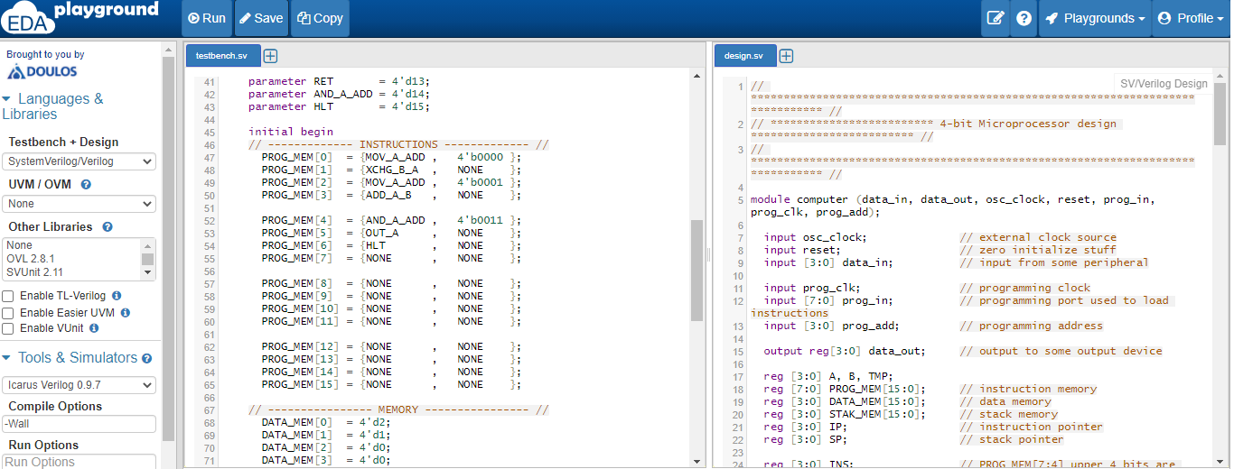
Sample Run-1 on EDA Playground

Slide 24
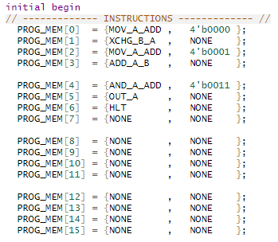
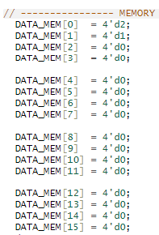
Sample Run-1 on EDA Playground
Address | Instruction Memory | Data Memory
0 | MOV A, [0000] | D2
1 | XCHG B, A | D1
2 | MOV A, [0001] | D0
3 | ADD A, B | D0
4 | AND A, [0011] | -
5 | OUT A | -
6 | HLT | -
7 | - | -
8 | - | -
9 | - | -
10 | - | -
11 | - | -
12 | - | -
13 | - | -
14 | - | -
15 | - | -
Testbench Code
PROG_MEM
DATA_MEM

Slide 25
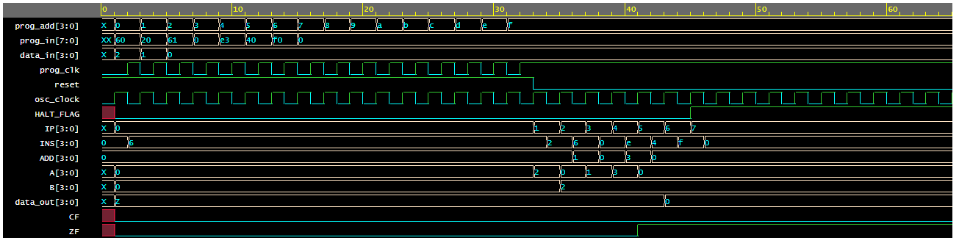
Sample Run-1 on EDA Playground
Output Waveshape

Slide 26
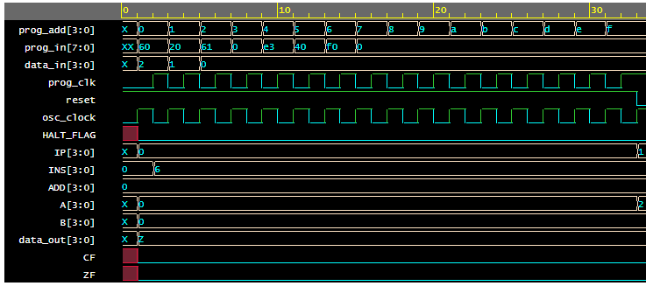
Sample Run-1 on EDA Playground
Program and Data Loading
Program address increasing from 0 to 15

Slide 27
Sample Run-1 on EDA Playground
Program and Data Loading
On each posedge of prog_clk, program and data is loaded into the computer address by address

Slide 28
Sample Run-1 on EDA Playground
Program and Data Loading
After loading all 16 addresses, reset pin is set to 0 and computer starts executing

Slide 29
Sample Run-1 on EDA Playground
Program and Data Loading
During loading, the internal registers have no/garbage data

Slide 30
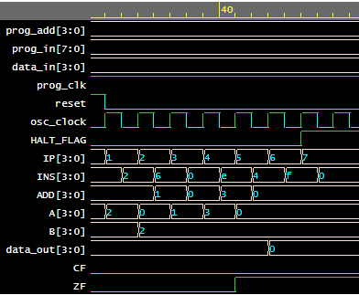
Sample Run-1 on EDA Playground
 | Instruction Memory | Data
0 | MOV A, [0000] | D2
1 | XCHG B, A | D1
2 | MOV A, [0001] | D0
3 | ADD A, B | D0
4 | AND A, [0011] | -
5 | OUT A | -
6 | HLT | -
7 | - | -
8 | - | -
9 | - | -
10 | - | -
11 | - | -
12 | - | -
13 | - | -
14 | - | -
15 | - | -
Execution
No jump/call operation, instruction pointer increases steadily

Slide 31
Sample Run-1 on EDA Playground
 | Instruction Memory | Data
0 | MOV A, [0000] | D2
1 | XCHG B, A | D1
2 | MOV A, [0001] | D0
3 | ADD A, B | D0
4 | AND A, [0011] | -
5 | OUT A | -
6 | HLT | -
7 | - | -
8 | - | -
9 | - | -
10 | - | -
11 | - | -
12 | - | -
13 | - | -
14 | - | -
15 | - | -
Execution
(Fetch cycle) Instruction register and address register loads information on negative clock edge

Slide 32
Sample Run-1 on EDA Playground
 | Instruction Memory | Data
0 | MOV A, [0000] | D2
1 | XCHG B, A | D1
2 | MOV A, [0001] | D0
3 | ADD A, B | D0
4 | AND A, [0011] | -
5 | OUT A | -
6 | HLT | -
7 | - | -
8 | - | -
9 | - | -
10 | - | -
11 | - | -
12 | - | -
13 | - | -
14 | - | -
15 | - | -
Execution
Execution of instructions are on positive edge of clock

Slide 33
Sample Run-1 on EDA Playground
 | Instruction Memory | Data
0 | MOV A, [0000] | D2
1 | XCHG B, A | D1
2 | MOV A, [0001] | D0
3 | ADD A, B | D0
4 | AND A, [0011] | -
5 | OUT A | -
6 | HLT | -
7 | - | -
8 | - | -
9 | - | -
10 | - | -
11 | - | -
12 | - | -
13 | - | -
14 | - | -
15 | - | -
Execution
Cycle 1:
Data=2 is loaded from memory 0 into reg A

Slide 34
Sample Run-1 on EDA Playground
 | Instruction Memory | Data
0 | MOV A, [0000] | D2
1 | XCHG B, A | D1
2 | MOV A, [0001] | D0
3 | ADD A, B | D0
4 | AND A, [0011] | -
5 | OUT A | -
6 | HLT | -
7 | - | -
8 | - | -
9 | - | -
10 | - | -
11 | - | -
12 | - | -
13 | - | -
14 | - | -
15 | - | -
Execution
Cycle 2:
reg B, reg A swap data

Slide 35
Sample Run-1 on EDA Playground
 | Instruction Memory | Data
0 | MOV A, [0000] | D2
1 | XCHG B, A | D1
2 | MOV A, [0001] | D0
3 | ADD A, B | D0
4 | AND A, [0011] | -
5 | OUT A | -
6 | HLT | -
7 | - | -
8 | - | -
9 | - | -
10 | - | -
11 | - | -
12 | - | -
13 | - | -
14 | - | -
15 | - | -
Execution
Cycle 3:
Data=1 is loaded from memory 1 into reg A

Slide 36
Sample Run-1 on EDA Playground
 | Instruction Memory | Data
0 | MOV A, [0000] | D2
1 | XCHG B, A | D1
2 | MOV A, [0001] | D0
3 | ADD A, B | D0
4 | AND A, [0011] | -
5 | OUT A | -
6 | HLT | -
7 | - | -
8 | - | -
9 | - | -
10 | - | -
11 | - | -
12 | - | -
13 | - | -
14 | - | -
15 | - | -
Execution
Cycle 4:
ADD A, B saves the sum on reg A

Slide 37
Sample Run-1 on EDA Playground
 | Instruction Memory | Data
0 | MOV A, [0000] | D2
1 | XCHG B, A | D1
2 | MOV A, [0001] | D0
3 | ADD A, B | D0
4 | AND A, [0011] | -
5 | OUT A | -
6 | HLT | -
7 | - | -
8 | - | -
9 | - | -
10 | - | -
11 | - | -
12 | - | -
13 | - | -
14 | - | -
15 | - | -
Execution
Cycle 5:
reg A AND operation with data = 0 at memory location 3, zero flag goes to 1 for 0 output

Slide 38
Sample Run-1 on EDA Playground
 | Instruction Memory | Data
0 | MOV A, [0000] | D2
1 | XCHG B, A | D1
2 | MOV A, [0001] | D0
3 | ADD A, B | D0
4 | AND A, [0011] | -
5 | OUT A | -
6 | HLT | -
7 | - | -
8 | - | -
9 | - | -
10 | - | -
11 | - | -
12 | - | -
13 | - | -
14 | - | -
15 | - | -
Execution
Cycle 6:
Contents of reg A are output

Slide 39
Sample Run-1 on EDA Playground
 | Instruction Memory | Data
0 | MOV A, [0000] | D2
1 | XCHG B, A | D1
2 | MOV A, [0001] | D0
3 | ADD A, B | D0
4 | AND A, [0011] | -
5 | OUT A | -
6 | HLT | -
7 | - | -
8 | - | -
9 | - | -
10 | - | -
11 | - | -
12 | - | -
13 | - | -
14 | - | -
15 | - | -
Execution
Cycle 7:
Computer reaches halt, instruction pointer no longer increases

Slide 40
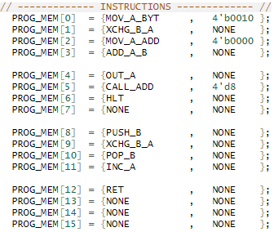
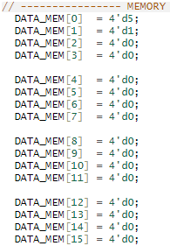
Sample Run-2 on EDA Playground
 | Instruction Memory | Data
0 | MOV A, 0010 | D5
1 | XCHG B, A | D1
2 | MOV A, [0000] | -
3 | ADD A, B | -
4 | OUT A | -
5 | CALL [d8] | -
6 | HLT | -
7 | - | -
8 | PUSH B | -
9 | XCHG B, A | -
10 | POP B | -
11 | INC A | -
12 | RET | -
13 | - | -
14 | - | -
15 | - | -
Testbench Code
PROG_MEM
DATA_MEM

Slide 41
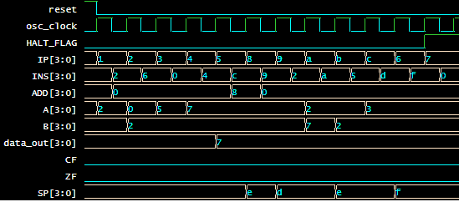
Sample Run-2 on EDA Playground
 | Instruction Memory | Data
0 | MOV A, 0010 | D5
1 | XCHG B, A | D1
2 | MOV A, [0000] | -
3 | ADD A, B | -
4 | OUT A | -
5 | CALL [d8] | -
6 | HLT | -
7 | - | -
8 | PUSH B | -
9 | XCHG B, A | -
10 | POP B | -
11 | INC A | -
12 | RET | -
13 | - | -
14 | - | -
15 | - | -
Execution
Call, return, push and pop are executed in this example program

Slide 42
Sample Run-2 on EDA Playground
 | Instruction Memory | Data
0 | MOV A, 0010 | D5
1 | XCHG B, A | D1
2 | MOV A, [0000] | -
3 | ADD A, B | -
4 | OUT A | -
5 | CALL [d8] | -
6 | HLT | -
7 | - | -
8 | PUSH B | -
9 | XCHG B, A | -
10 | POP B | -
11 | INC A | -
12 | RET | -
13 | - | -
14 | - | -
15 | - | -
Execution
Cycle 1:
MOV A, 0010 moves value 2 into A

Slide 43
Sample Run-2 on EDA Playground
 | Instruction Memory | Data
0 | MOV A, 0010 | D5
1 | XCHG B, A | D1
2 | MOV A, [0000] | -
3 | ADD A, B | -
4 | OUT A | -
5 | CALL [d8] | -
6 | HLT | -
7 | - | -
8 | PUSH B | -
9 | XCHG B, A | -
10 | POP B | -
11 | INC A | -
12 | RET | -
13 | - | -
14 | - | -
15 | - | -
Execution
Cycle 2:
B and A registers swap values

Slide 44
Sample Run-2 on EDA Playground
 | Instruction Memory | Data
0 | MOV A, 0010 | D5
1 | XCHG B, A | D1
2 | MOV A, [0000] | -
3 | ADD A, B | -
4 | OUT A | -
5 | CALL [d8] | -
6 | HLT | -
7 | - | -
8 | PUSH B | -
9 | XCHG B, A | -
10 | POP B | -
11 | INC A | -
12 | RET | -
13 | - | -
14 | - | -
15 | - | -
Execution
Cycle 3:
MOV A, [0000] moves value 5 on memory 0 into A

Slide 45
Sample Run-2 on EDA Playground
 | Instruction Memory | Data
0 | MOV A, 0010 | D5
1 | XCHG B, A | D1
2 | MOV A, [0000] | -
3 | ADD A, B | -
4 | OUT A | -
5 | CALL [d8] | -
6 | HLT | -
7 | - | -
8 | PUSH B | -
9 | XCHG B, A | -
10 | POP B | -
11 | INC A | -
12 | RET | -
13 | - | -
14 | - | -
15 | - | -
Execution
Cycle 4:
ADD A, B stores sum 2+5=7 in A

Slide 46
Sample Run-2 on EDA Playground
 | Instruction Memory | Data
0 | MOV A, 0010 | D5
1 | XCHG B, A | D1
2 | MOV A, [0000] | -
3 | ADD A, B | -
4 | OUT A | -
5 | CALL [d8] | -
6 | HLT | -
7 | - | -
8 | PUSH B | -
9 | XCHG B, A | -
10 | POP B | -
11 | INC A | -
12 | RET | -
13 | - | -
14 | - | -
15 | - | -
Execution
Cycle 5:
Value of A=5 output

Slide 47
Sample Run-2 on EDA Playground
 | Instruction Memory | Data
0 | MOV A, 0010 | D5
1 | XCHG B, A | D1
2 | MOV A, [0000] | -
3 | ADD A, B | -
4 | OUT A | -
5 | CALL [d8] | -
6 | HLT | -
7 | - | -
8 | PUSH B | -
9 | XCHG B, A | -
10 | POP B | -
11 | INC A | -
12 | RET | -
13 | - | -
14 | - | -
15 | - | -
Execution
Cycle 6:
Calling instruction at memory location 8 sets instruction pointer to 8, pushes the current location to stack, stack pointer decreases from 15(f) to 14 (e)

Slide 48
Sample Run-2 on EDA Playground
 | Instruction Memory | Data
0 | MOV A, 0010 | D5
1 | XCHG B, A | D1
2 | MOV A, [0000] | -
3 | ADD A, B | -
4 | OUT A | -
5 | CALL [d8] | -
6 | HLT | -
7 | - | -
8 | PUSH B | -
9 | XCHG B, A | -
10 | POP B | -
11 | INC A | -
12 | RET | -
13 | - | -
14 | - | -
15 | - | -
Execution
Cycle 7:
Value of B=2 is pushed to the stack, stack pointer reduced by another step

Slide 49
Sample Run-2 on EDA Playground
 | Instruction Memory | Data
0 | MOV A, 0010 | D5
1 | XCHG B, A | D1
2 | MOV A, [0000] | -
3 | ADD A, B | -
4 | OUT A | -
5 | CALL [d8] | -
6 | HLT | -
7 | - | -
8 | PUSH B | -
9 | XCHG B, A | -
10 | POP B | -
11 | INC A | -
12 | RET | -
13 | - | -
14 | - | -
15 | - | -
Execution
Cycle 8:
A and B swapped, A = 2 and B = 7

Slide 50
Sample Run-2 on EDA Playground
 | Instruction Memory | Data
0 | MOV A, 0010 | D5
1 | XCHG B, A | D1
2 | MOV A, [0000] | -
3 | ADD A, B | -
4 | OUT A | -
5 | CALL [d8] | -
6 | HLT | -
7 | - | -
8 | PUSH B | -
9 | XCHG B, A | -
10 | POP B | -
11 | INC A | -
12 | RET | -
13 | - | -
14 | - | -
15 | - | -
Execution
Cycle 9:
POP B increases stack pointer, pops the value 2 from stack, saves in B

Slide 51
Sample Run-2 on EDA Playground
 | Instruction Memory | Data
0 | MOV A, 0010 | D5
1 | XCHG B, A | D1
2 | MOV A, [0000] | -
3 | ADD A, B | -
4 | OUT A | -
5 | CALL [d8] | -
6 | HLT | -
7 | - | -
8 | PUSH B | -
9 | XCHG B, A | -
10 | POP B | -
11 | INC A | -
12 | RET | -
13 | - | -
14 | - | -
15 | - | -
Execution
Cycle 10:
INC A increases A from 2 to 3

Slide 52
Sample Run-2 on EDA Playground
 | Instruction Memory | Data
0 | MOV A, 0010 | D5
1 | XCHG B, A | D1
2 | MOV A, [0000] | -
3 | ADD A, B | -
4 | OUT A | -
5 | CALL [d8] | -
6 | HLT | -
7 | - | -
8 | PUSH B | -
9 | XCHG B, A | -
10 | POP B | -
11 | INC A | -
12 | RET | -
13 | - | -
14 | - | -
15 | - | -
Execution
Cycle 11:
Increases stack pointer, retrieves memory location = 5, jumps to that instruction and IP increased to 6

Slide 53
Sample Run-2 on EDA Playground
 | Instruction Memory | Data
0 | MOV A, 0010 | D5
1 | XCHG B, A | D1
2 | MOV A, [0000] | -
3 | ADD A, B | -
4 | OUT A | -
5 | CALL [d8] | -
6 | HLT | -
7 | - | -
8 | PUSH B | -
9 | XCHG B, A | -
10 | POP B | -
11 | INC A | -
12 | RET | -
13 | - | -
14 | - | -
15 | - | -
Execution
Cycle 12:
Program halts

Slide 54
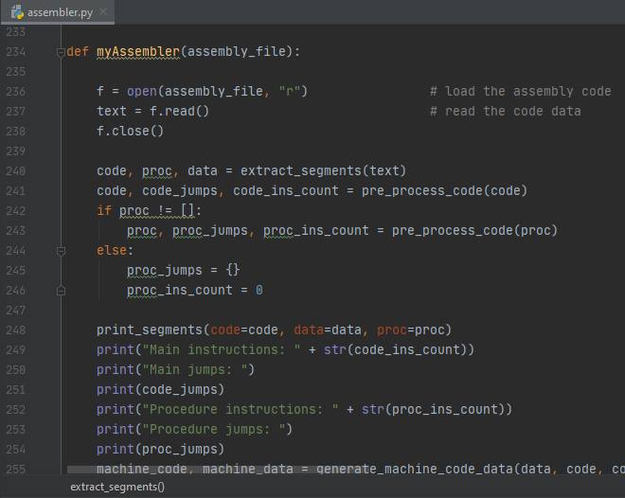
Python Assembler
FEATURES:
Data segment and code segment
Data in variable format (x, y, z etc var name)
Multiple Jump instructions supported
0-1 procedure supported
Machine code generation in binary/Verilog assignment statement format from .asm files
USAGE:
>> python assembler.py addition_example.asm

Slide 55
Python Assembler
.DATA x 1 y 4 z 2 .END_DATA .CODE MOV A, x XCHG B, A MOV A, y HERE: CALL DECREASE XCHG B, A MOV A, z SUB A, B JZ HERE OUT A HLT .PROC DECREASE SUB A, B SUB A, B RET .END_PROC .END_CODE
Addition_example.asm
_______CODE_______
['MOV A, x', 'XCHG B, A', 'MOV A, y', 'CALL DECREASE', 'XCHG B, A', 'MOV A, z', 'SUB A, B', 'JZ HERE', 'OUT A', 'HLT']
_______PROC_______
['SUB A, B', 'SUB A, B', 'RET']
_______VARS_______
{'x': [0, 1], 'y': [1, 4], 'z': [2, 2]}
_______STOP_______
Main instructions: 10
Main jumps:
{'HERE': 3}
Procedure instructions: 3
Procedure jumps:
{}
Machine Code:
['01100000', '00100000', '01100001', '11001010', '00100000', '01100010', '00010000', '10000011', '01000000', '11110000', '00010000', '00010000', '11010000']
Machine Data:
['0001', '0100', '0010']
Command Line Output

Slide 56
Python Assembler
.DATA x 1 y 4 z 2 .END_DATA .CODE MOV A, x XCHG B, A MOV A, y HERE: CALL DECREASE XCHG B, A MOV A, z SUB A, B JZ HERE OUT A HLT .PROC DECREASE SUB A, B SUB A, B RET .END_PROC .END_CODE
Addition_example.asm
Addition_example.v
PROG_MEM[0] = 8'b01100000;
PROG_MEM[1] = 8'b00100000;
PROG_MEM[2] = 8'b01100001;
PROG_MEM[3] = 8'b11001010;
PROG_MEM[4] = 8'b00100000;
PROG_MEM[5] = 8'b01100010;
PROG_MEM[6] = 8'b00010000;
PROG_MEM[7] = 8'b10000011;
PROG_MEM[8] = 8'b01000000;
PROG_MEM[9] = 8'b11110000;
PROG_MEM[10] = 8'b00010000;
PROG_MEM[11] = 8'b00010000;
PROG_MEM[12] = 8'b11010000;
PROG_MEM[13] = 8'b00000000;
PROG_MEM[14] = 8'b00000000;
PROG_MEM[15] = 8'b00000000;
DATA_MEM[0] = 4'b0001;
DATA_MEM[1] = 4'b0100;
DATA_MEM[2] = 4'b0010;
DATA_MEM[3] = 4'b0000;
DATA_MEM[4] = 4'b0000;
DATA_MEM[5] = 4'b0000;
DATA_MEM[6] = 4'b0000;
DATA_MEM[7] = 4'b0000;
DATA_MEM[8] = 4'b0000;
DATA_MEM[9] = 4'b0000;
DATA_MEM[10] = 4'b0000;
DATA_MEM[11] = 4'b0000;
DATA_MEM[12] = 4'b0000;
DATA_MEM[13] = 4'b0000;
DATA_MEM[14] = 4'b0000;
DATA_MEM[15] = 4'b0000;
This data has to be pasted onto testbench code for proof of operation

Slide 57
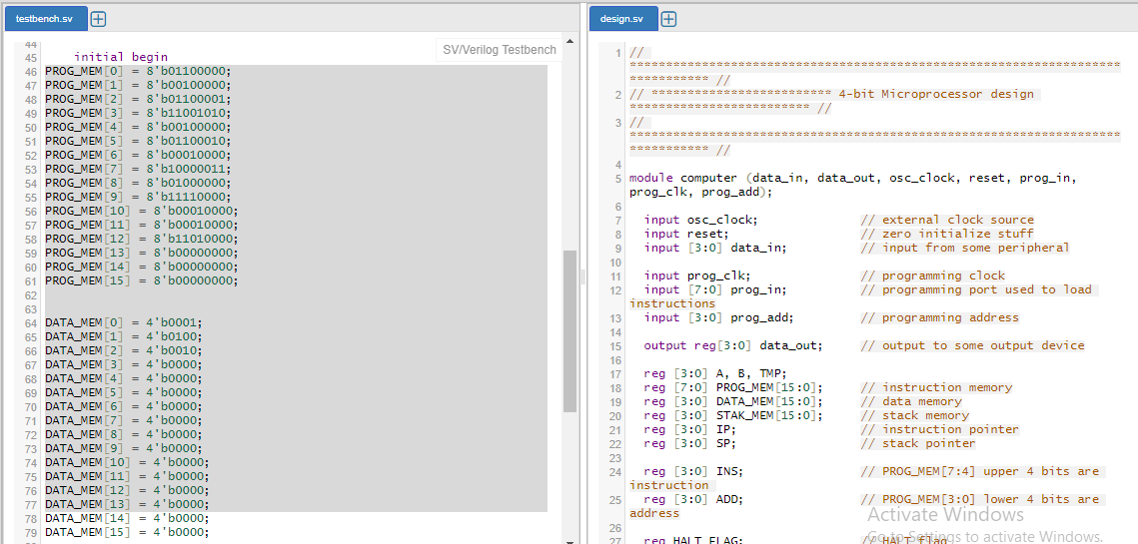
Python Assembler

Slide 58
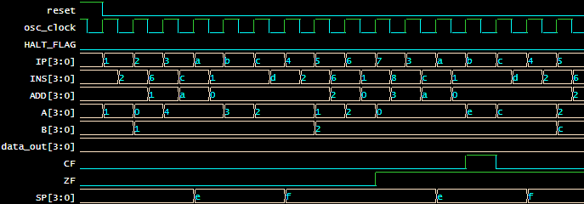
Python Assembler
Execution of assembled code on EDA-Playground

Slide 59
</THANK YOU>

